Slide 1


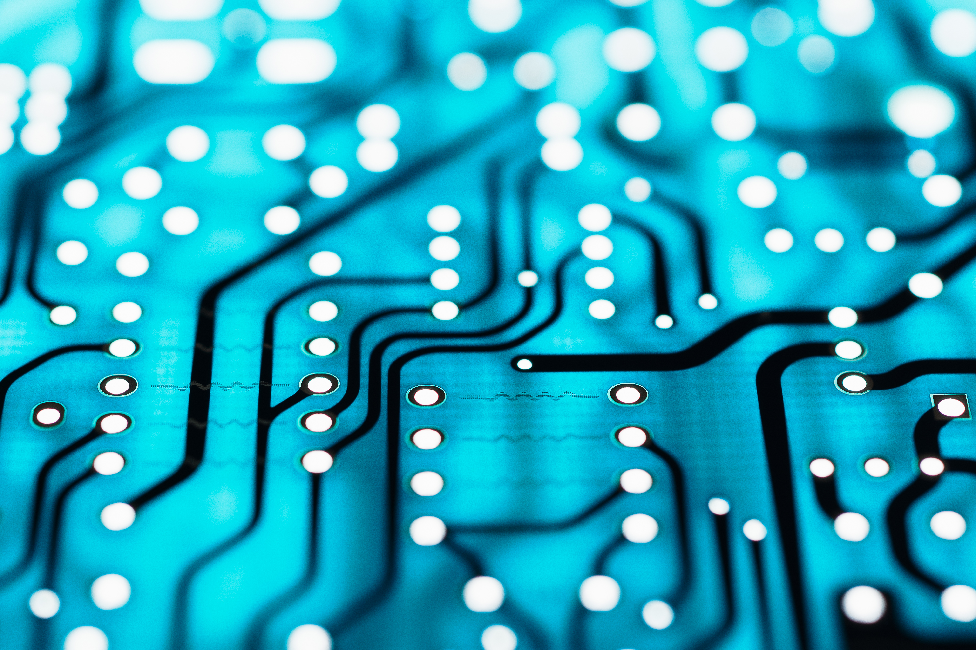
What Is python
Lucas Weaver

Slide 2
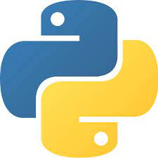
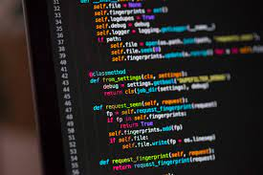
Python
Python is a simple yet very versatile programming language that is used in almost all disciplines of computing from graphics to machine learning.

Slide 3
What is a programming language
A programming language is a set of instructions which will tell the computer to do a certain task.
EX: Telling a computer to output something or store data

Slide 4
What are instruction
Instructions are very basic commands that tell the computer to do some kind of task.
EX: when you want to write a note you must first find a pen, find a piece of paper, pick it up, and write each letter.
Each of those different steps could be an instruction like pick_up_pen

Slide 5
What is an algorithm
An algorithm describes a specific set of steps which a computer must take to complete a certain task.
EX:
Task: put on shoes
Algorithm: Get socks, put on socks, put on shoes.

